Slide 1
Memory-efficient data structures
BDA Expt no 2

Slide 2
Bloom Filter
Probabilistic data structure

Slide 3
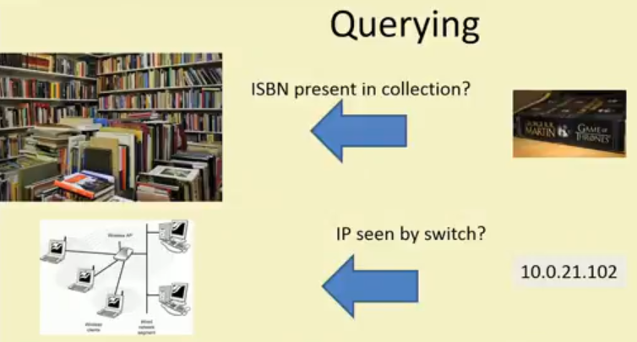

Slide 4


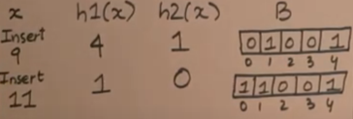
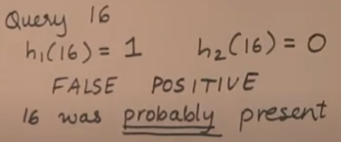


Slide 5
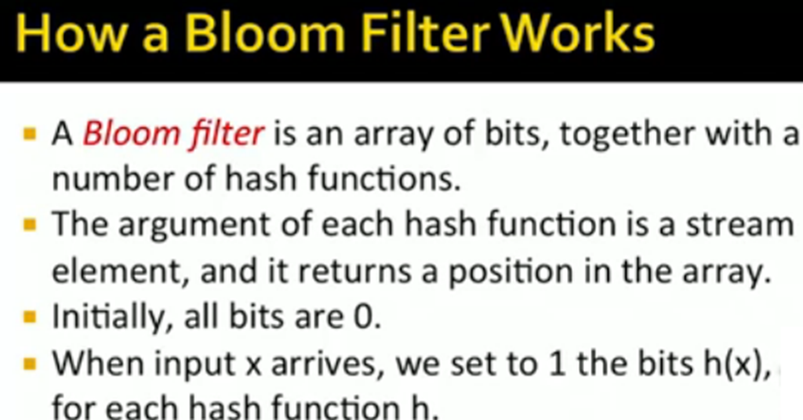

Slide 6
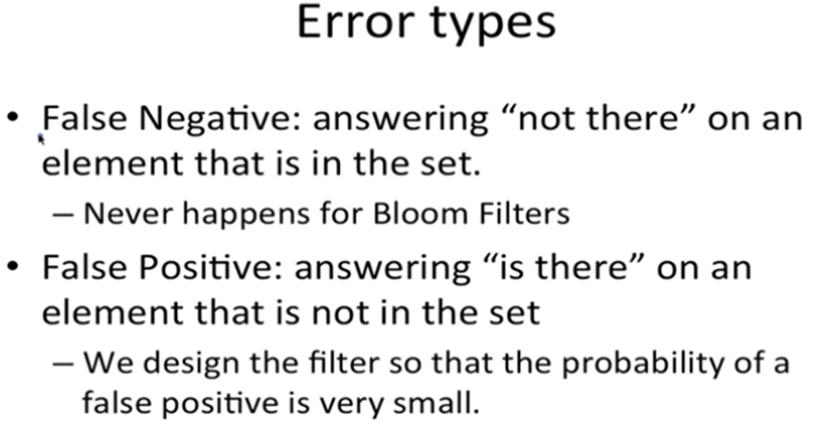

Slide 7
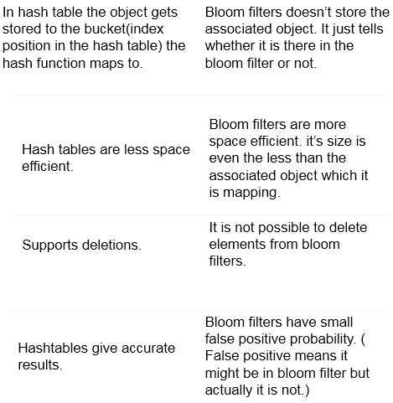

Slide 8
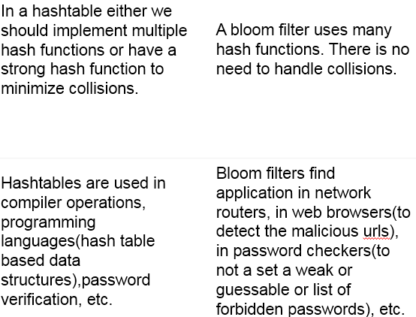

Slide 9
lClassic Uses of BF: Data Bases
lJoin: Combine two tables with a common domain into a single table. But it is costly operation in distributed DB.
lSemi-join: A join in distributed DBs in which only the joining attribute from one site is transmitted to the other site and used for selection. The selected records are sent back.
lBloom-join: A semi-join where we send only a BF of the joining attribute.

Slide 10
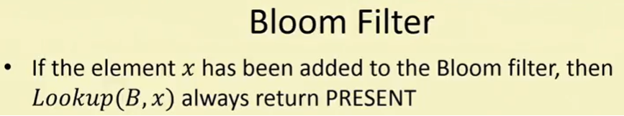
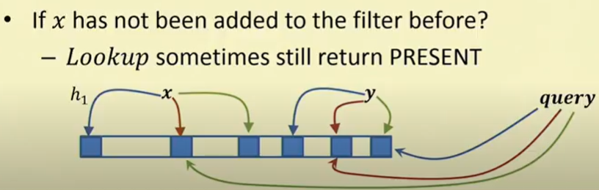

Slide 11
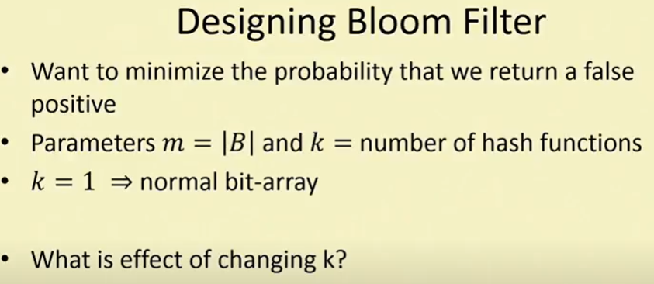

Slide 12
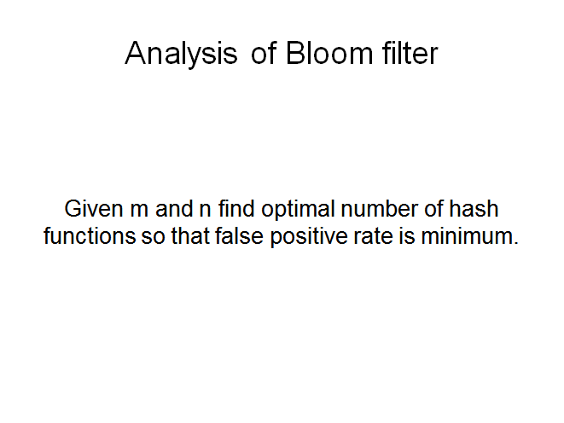

Slide 13
Probability of a false positive
Total no of cells in a bloom filter = m
lNo. of hash functions = k
Probability that one cell is mapped to 1 when one element is inserted is 1/m
Probability that a cell is not mapped to 1 when one element is inserted is 1 – 1/m
Therefore 1 – 1/m is the probability that a cell is not mapped to 1 when one element is inserted by that hash function.

Slide 14
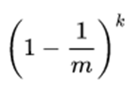
Probability of a false positive
But there are k hash functions.
Probability that a cell is not mapped to 1 when one element is inserted by k hash function is (1 – 1/m) (1 – 1/m) .... k times.

Slide 15

But there are n elements to be hashed.
Probability that a cell is not mapped to 1 when n elements are inserted by k hash function is
.... n times.

Slide 16


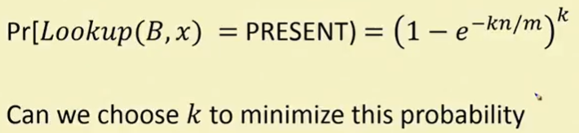

When Lookup will return present? When all of the k bits h₁(x),h₂(x)......h_{k}(x) return 1.

Slide 17
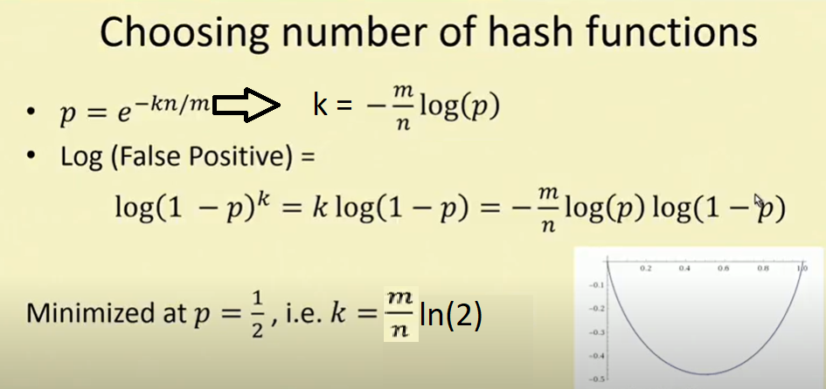

Slide 18
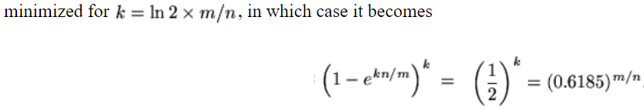

Slide 19
